Slide 1
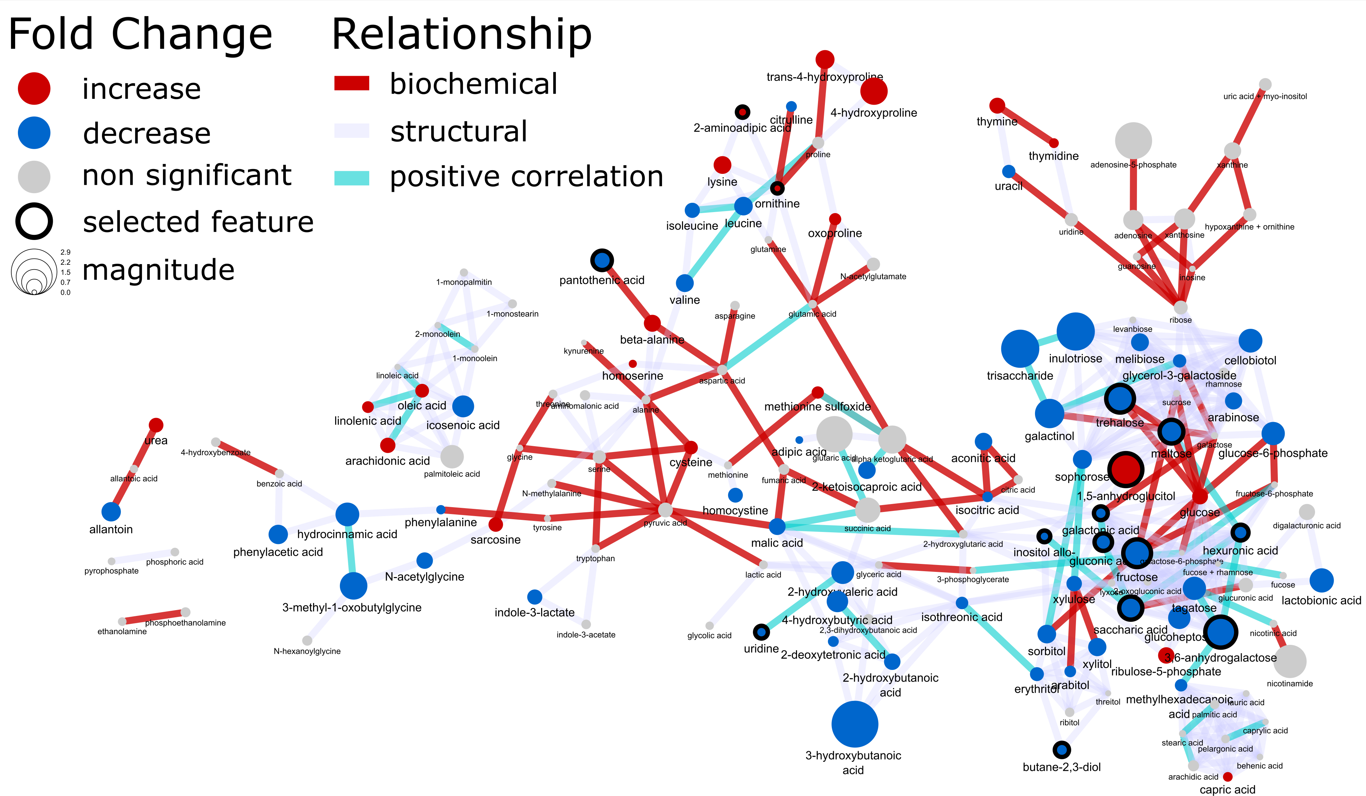
Welcome to network mapping 101
In the following course you will learn how to integrate statistical, multivariate and machine learning results within a publication quality biochemical network.

Slide 2
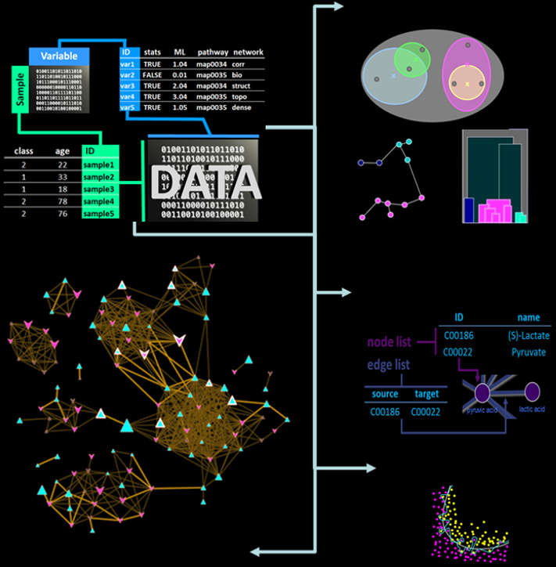
Tutorials
Preparing raw data for analysis
Statistical analysis
Multivariate data exploration
Supervised clustering
Machine learning
classification
model validation
feature selection
Network analysis
biochemical
structural similarity
correlation
Network mapping – putting it all together
https://creativedatasolutions.github.io/CDS.courses/courses/network_mapping_101/docs/#topics

Slide 3
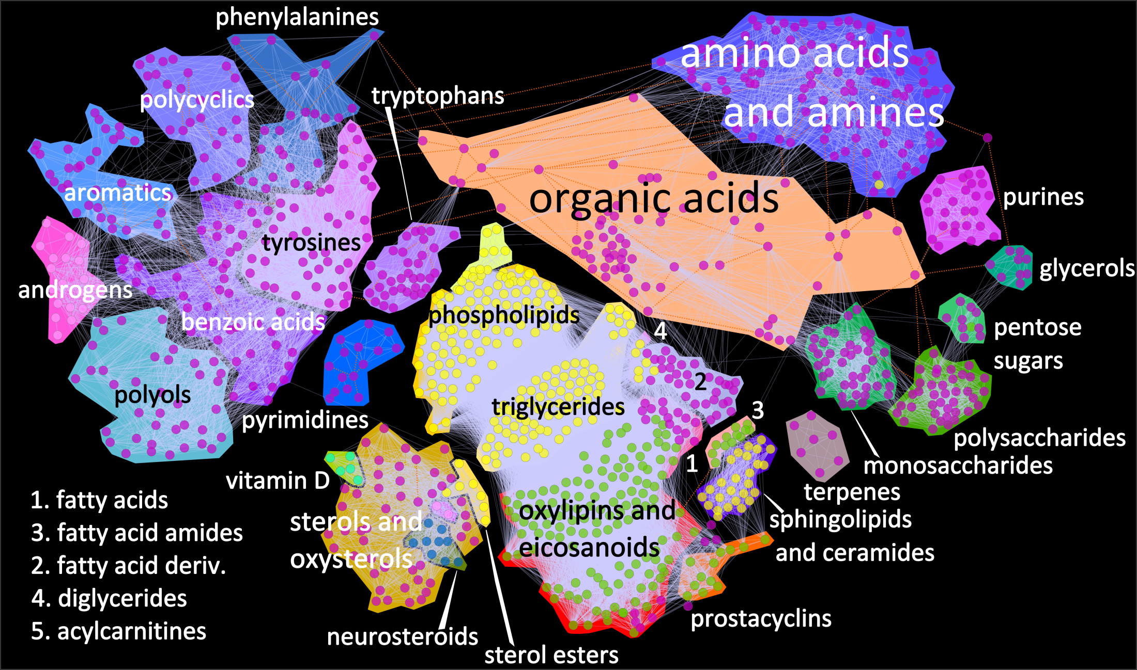
Analysis at the metabolomic scale

Slide 4
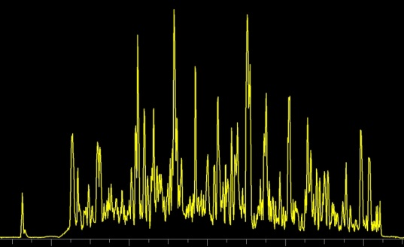
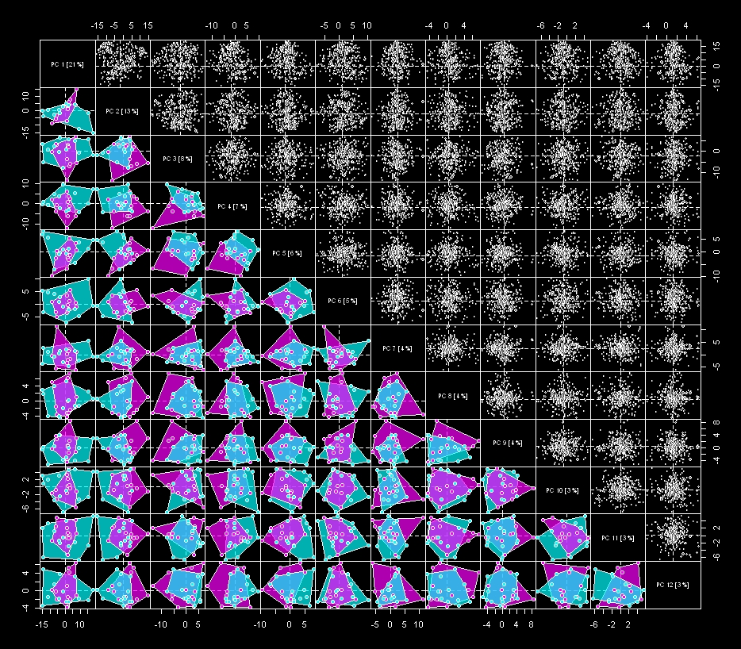
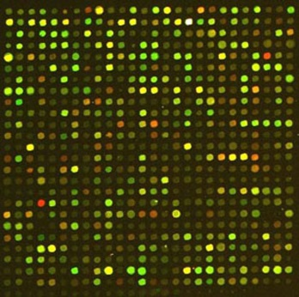
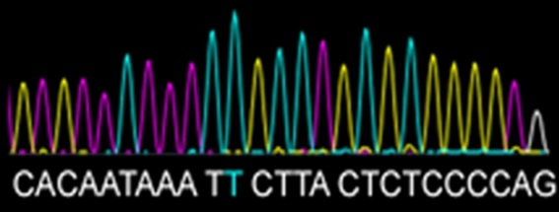
Integrate high-dimensional data
variables
Samples

Slide 5

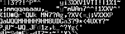
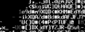
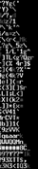
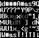
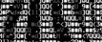

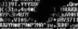

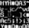
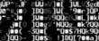
Identify what matters
Univariate
Multivariate
Predictive Modeling
Group 1
Group 2
ANOVA
PCA
PLS

Slide 6
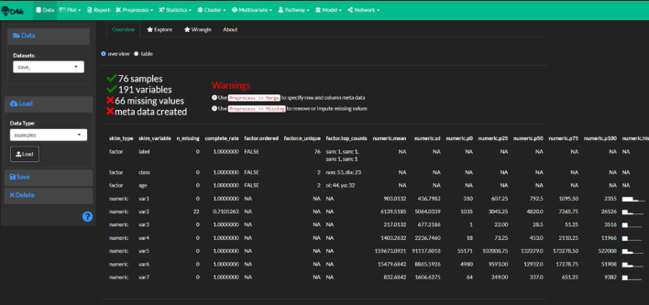
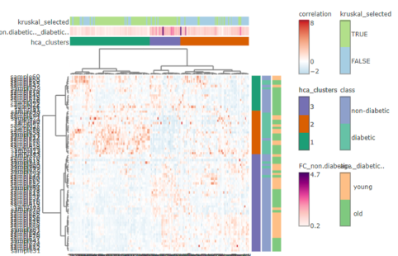
Topics
Data preparation
Differential expression
Hierarchical Clustering
Principal Components Analysis (PCA)
Statistical analysis
Machine learning
Network analysis
Network mapping
https://creativedatasolutions.github.io/CDS.courses/courses/network_mapping_101/docs/#topics

Slide 7
How to think about data complexity
variables
Experimental Design =
Meta Data
m
complexity
n
samples
Data
1-D
2-D
m-D
Variable # = dimensionality

Slide 8
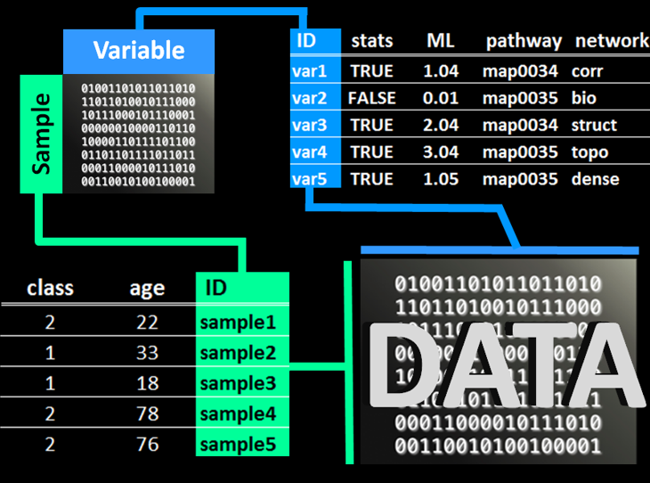
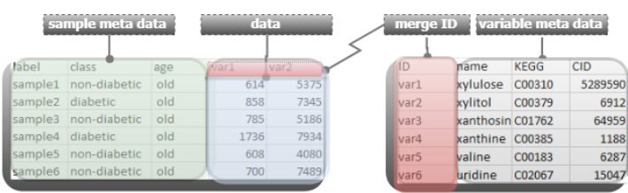
Data preprocessing
define
data
row meta data
column meta data
remove and/or impute
missing values
https://creativedatasolutions.github.io/CDS.courses/courses/network_mapping_101/docs/partial/preprocess/

Slide 9
Your turn
Follow along with the following tutorial:
https://creativedatasolutions.github.io/CDS.courses/courses/network_mapping_101/docs/partial/preprocess/

Slide 10
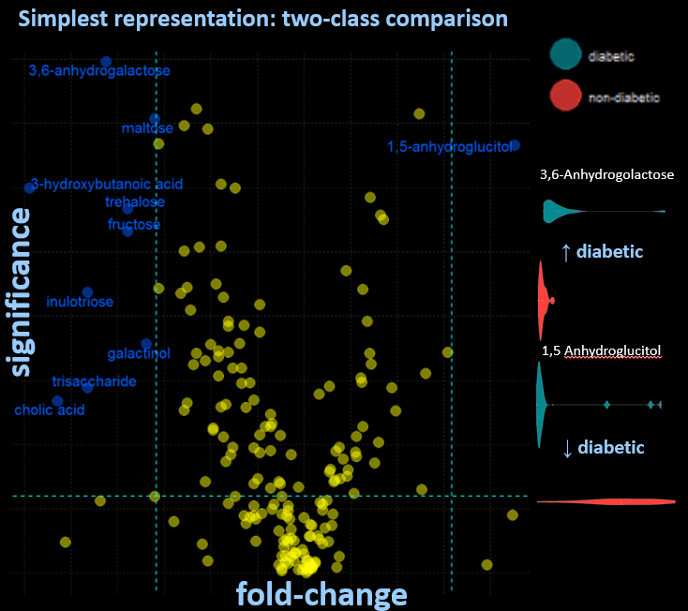
Differential expression
compare
class means
identify
significant differences
visualize
volcano plots
violin plots
https://creativedatasolutions.github.io/CDS.courses/courses/network_mapping_101/docs/partial/statistics/

Slide 11
Your turn
Follow along with the following tutorial:
https://creativedatasolutions.github.io/CDS.courses/courses/network_mapping_101/docs/partial/statistics/

Slide 12
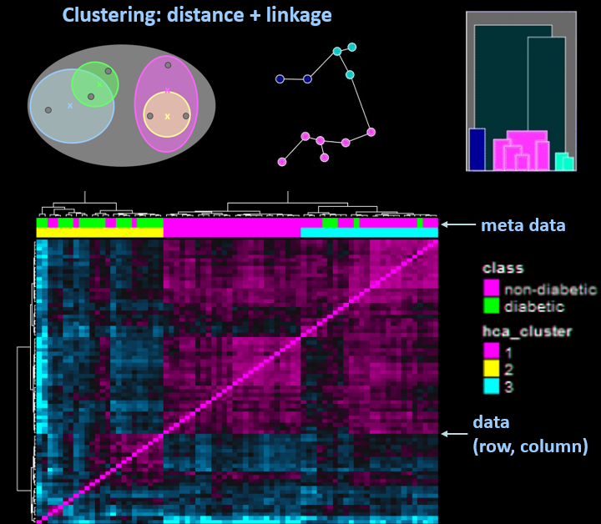
Hierarchical clustering (HCA)
group
samples and/or variables
define similarity
correlation
distance
linkage
visualize
heatmaps
dendrograms
https://creativedatasolutions.github.io/CDS.courses/courses/network_mapping_101/docs/partial/clustering/#heirarchical-clustering

Slide 13
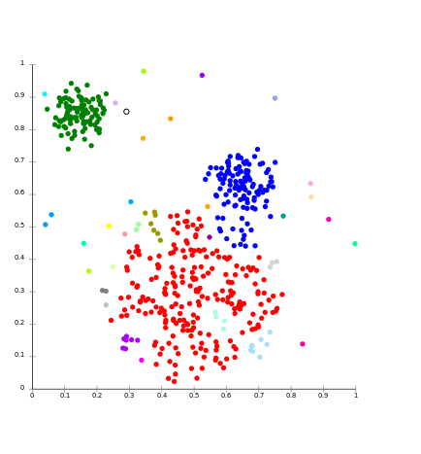
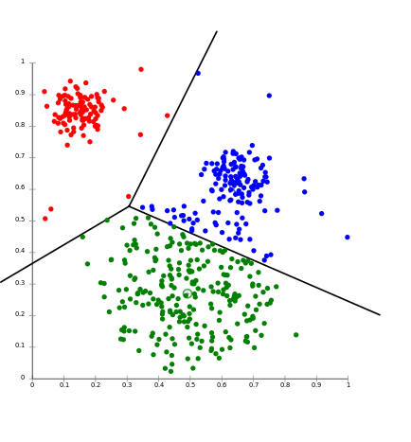
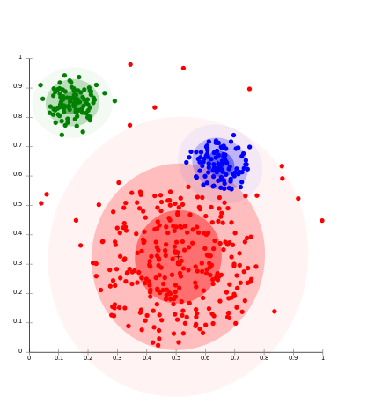

Clustering basics
Use the concept similarity/dissimilarity to group a collection of samples or variables
approaches
hierarchical (linkage)
non-hierarchical (k-NN, k-means)
distribution (mixtures models)
density (DBSCAN)
self organizing maps (SOM)
Linkage
k-means
Distribution
Density

Slide 14

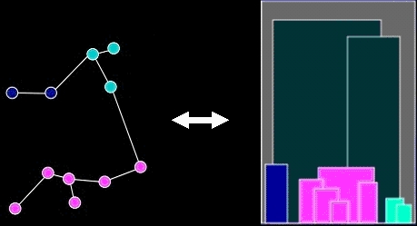
HCA goals
identify
patterns
group structure
relationships
evaluate and refine hypothesis
reduce complexity
Artist: Chuck Close

Slide 15
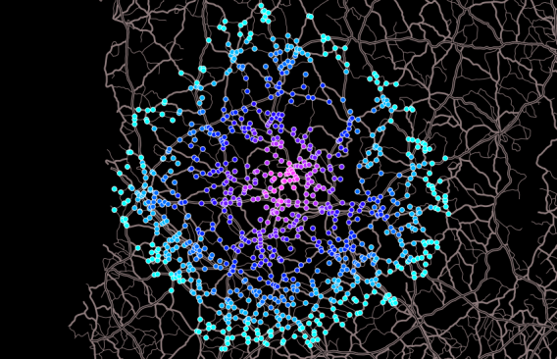
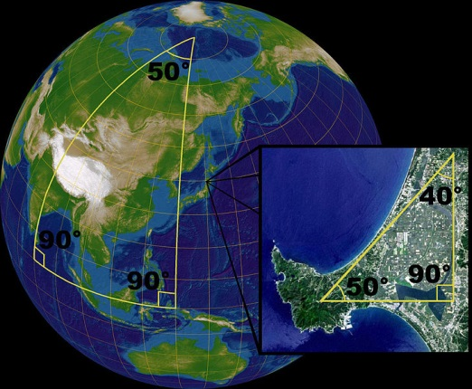
HCA methods
distance
defines “nearness” or similarity
Euclidean
Manhattan
Mahalanobis
non-Euclidean
X
X
X
*
Y
Y
Y

Slide 16
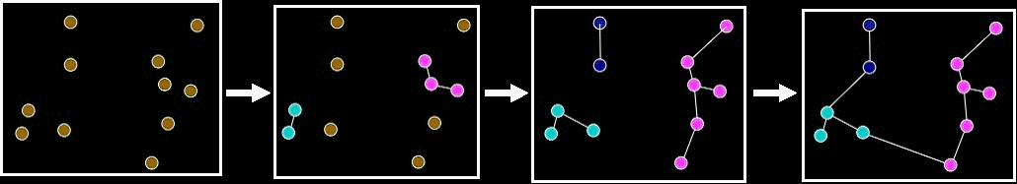
HCA methods
linkage or agglomeration
how samples or variables are connected or grouped
single
complete
centroid
average

Slide 17
HCA process
x
x
x
x
Similarity

Slide 18
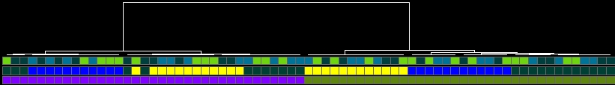
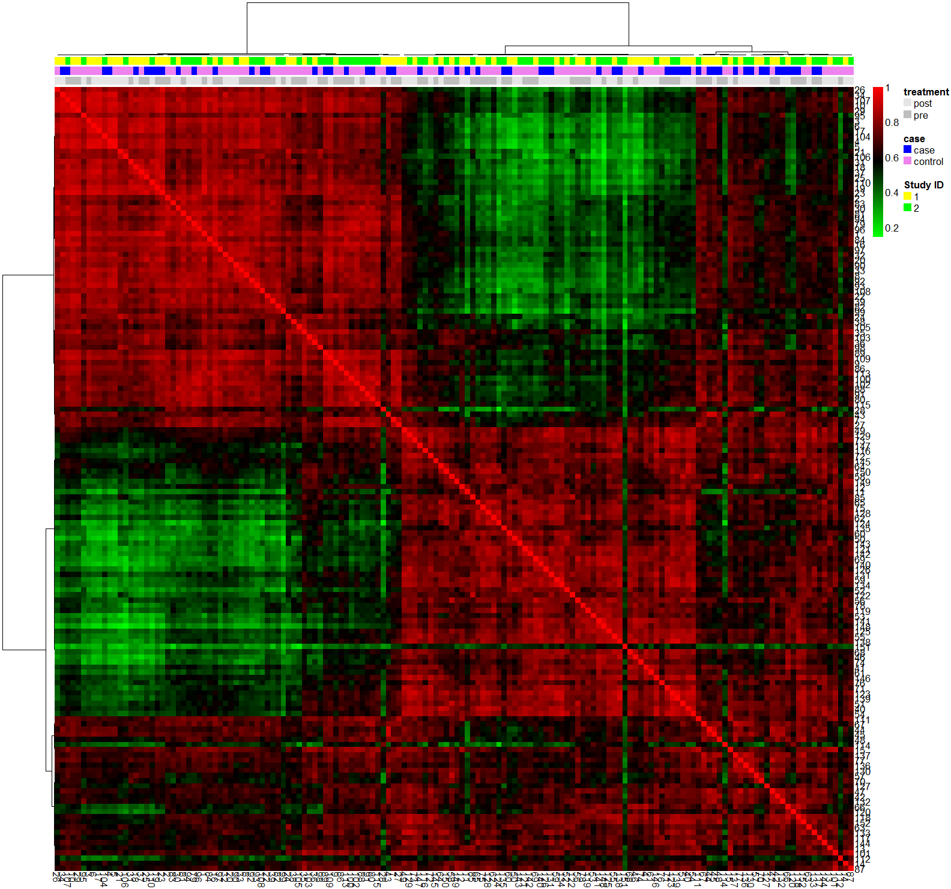
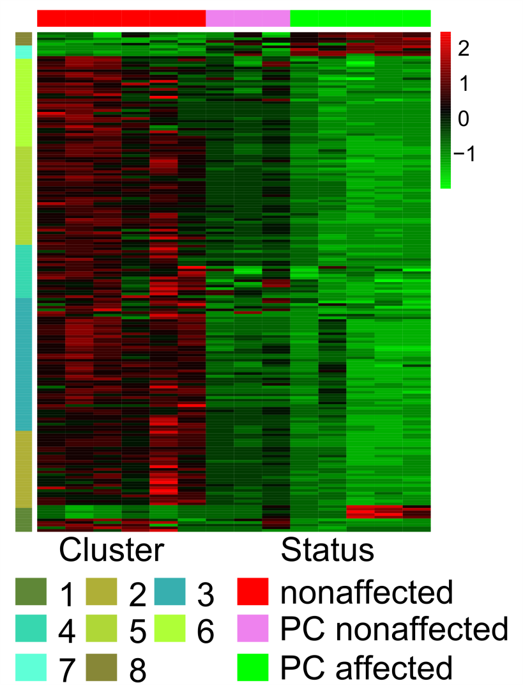
HCA interpretation
How does my metadata* match my data structure?
overview
confirmation
*
*
*

Slide 19
Your turn
Follow along with the following tutorial:
https://creativedatasolutions.github.io/CDS.courses/courses/network_mapping_101/docs/partial/clustering/#heirarchical-clustering

Slide 20
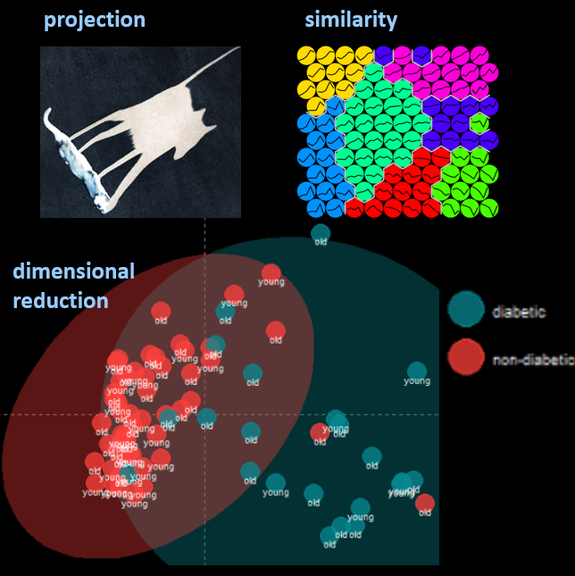
Principal Components Analysis (PCA)
reduce
dimensionality
maximize
variance explained
visualize
variance explained
outliers
sample scores
variable loadings
https://creativedatasolutions.github.io/CDS.courses/courses/network_mapping_101/docs/partial/multivariate/#pca

Slide 21
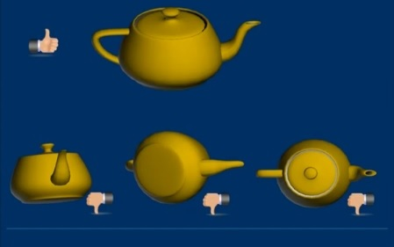
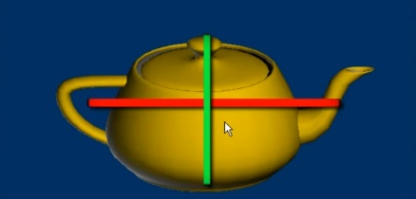
PCA goals
Principal Components (PCs)
non-supervised
projection of the data which maximize variance explained
results
eigenvalues = variance explained
scores = new coordinates for samples (rows)
loadings = linear combination of original variables
James X. Li, 2009, VisuMap Tech.

Slide 22
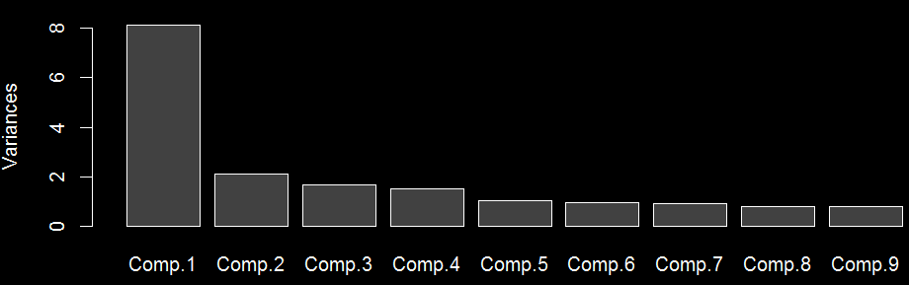
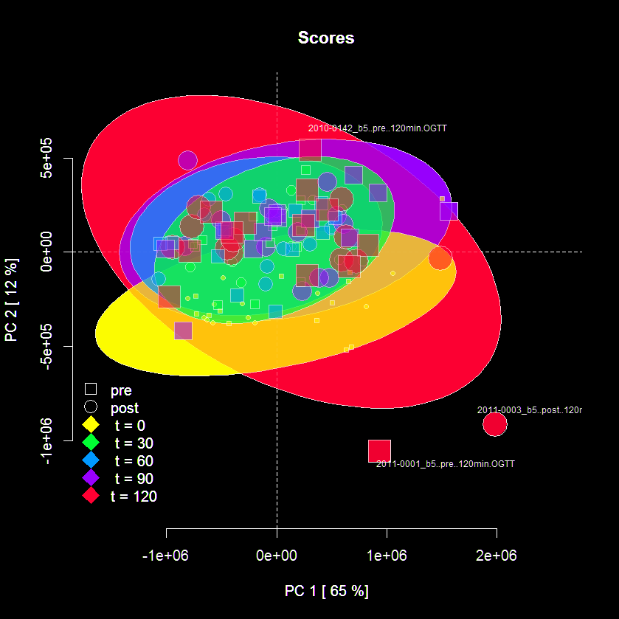
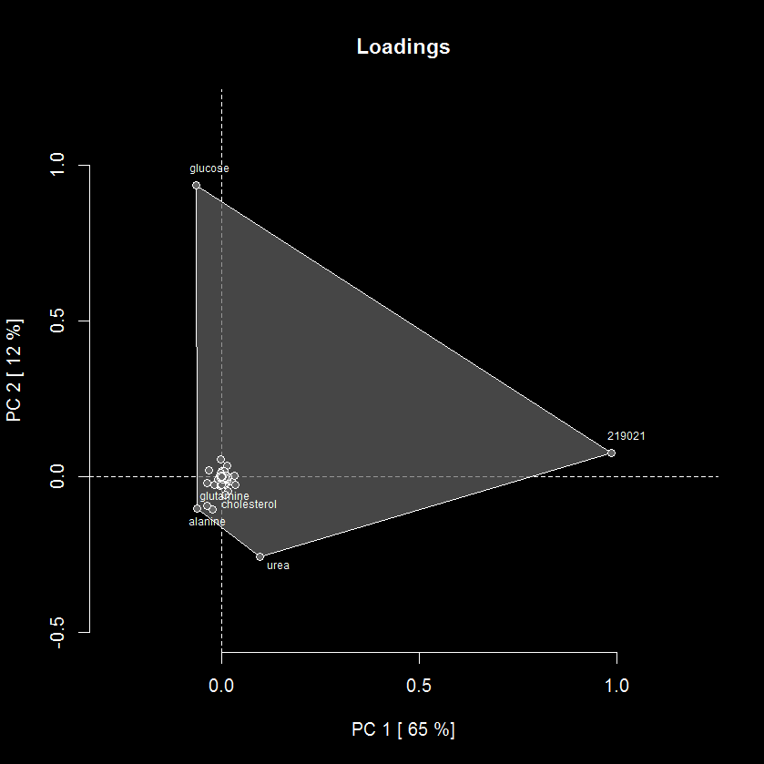
PCA interpretation
Variance explained (eigenvalues) Row (sample) scores and column (variable) loadings

Slide 23
PCA example
glucose
219021
*no scaling or centering

Slide 24
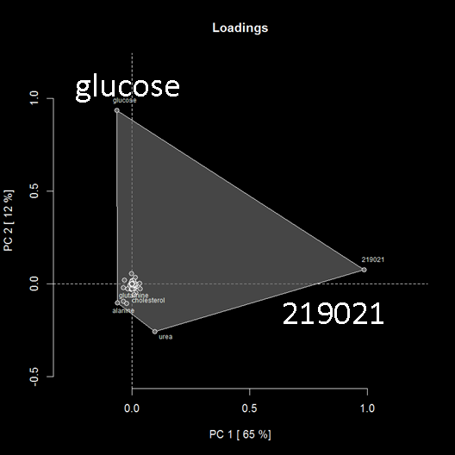
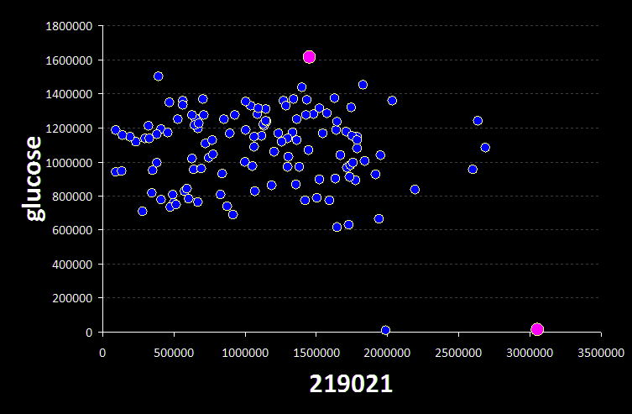
Relationship between
scores and loadings
loadings
top loading variable’s scatterplot
scores

Slide 25
Your turn
Follow along with the following tutorial:
https://creativedatasolutions.github.io/CDS.courses/courses/network_mapping_101/docs/partial/multivariate/#pca

Slide 26
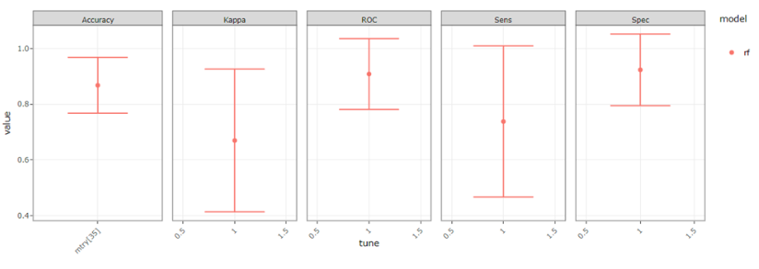
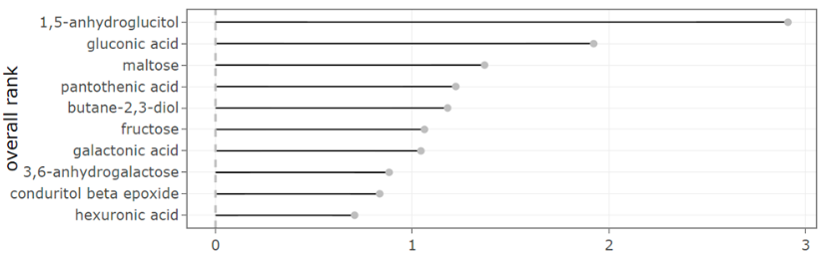
Machine learning
predict
sample classification
optimize
model performance
select
important features
visualize
model performance
feature importance
https://creativedatasolutions.github.io/CDS.courses/courses/network_mapping_101/docs/partial/model/

Slide 27
Your turn
Follow along with the following tutorial:
https://creativedatasolutions.github.io/CDS.courses/courses/network_mapping_101/docs/partial/model/

Slide 28
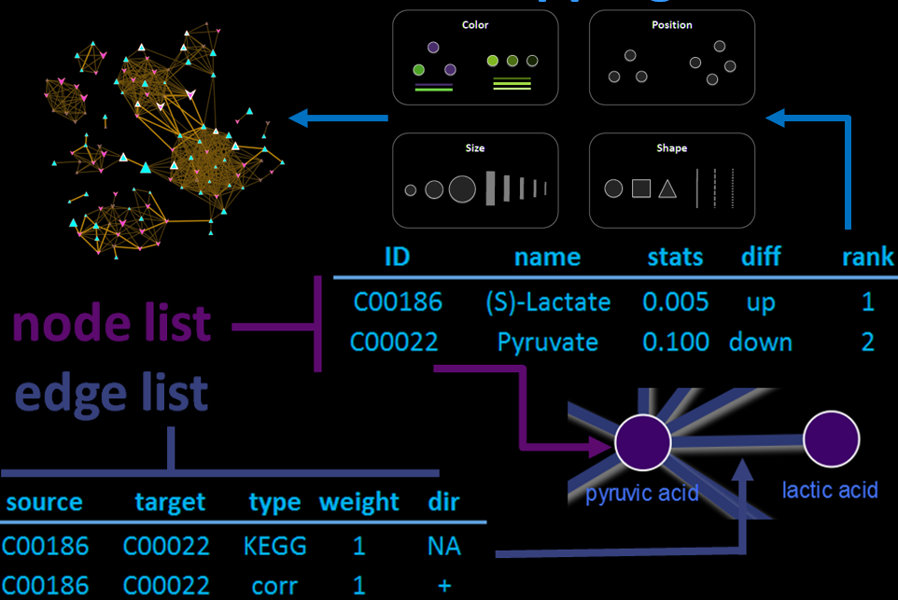
Network analysis
network mapping
transform variables
network calculation
regularized correlation
biochemical
structural similarity
model performance
visualize
interactive networks
https://creativedatasolutions.github.io/CDS.courses/courses/network_mapping_101/docs/partial/network/

Slide 29
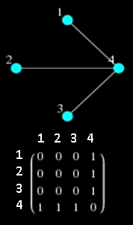
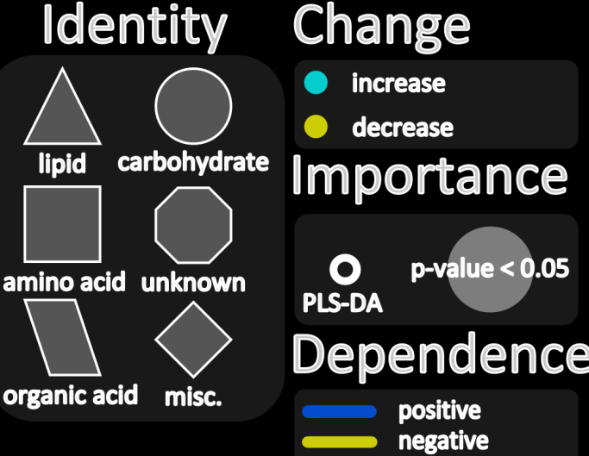
Components for network mapping
connections (edges)
empirical dependency (correlation)
biochemical (substrate/product)
chemical similarity
…
nodes (vertices)
magnitude
importance
direction
relationships
…

Slide 30
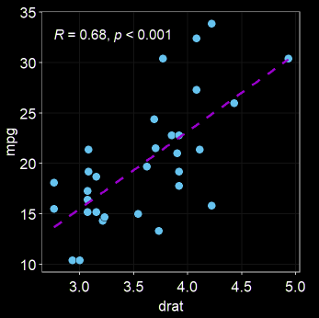
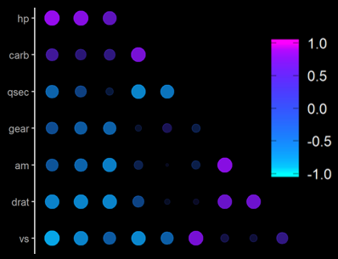
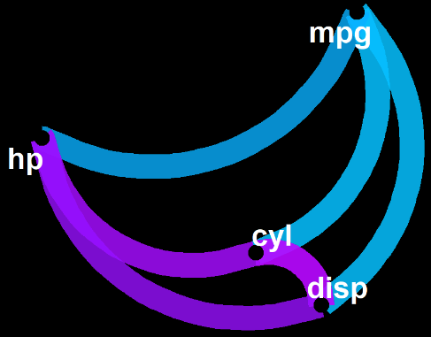
Correlation networks
Connect molecules based on strength of their correlation or partial-correlation
bivariate
multivariate
network

Slide 31
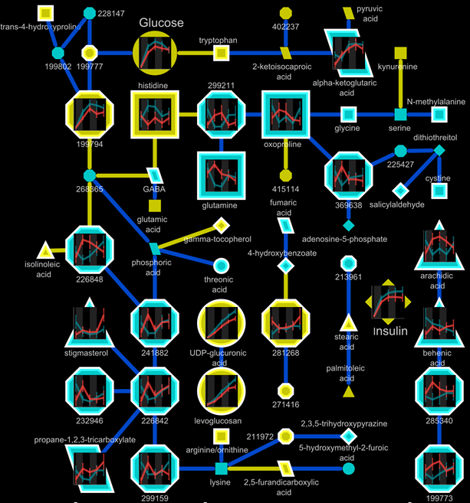
Correlation example
regularized correlation network showing relationships in metabolic timeseries measurements for two classes of samples

Slide 32
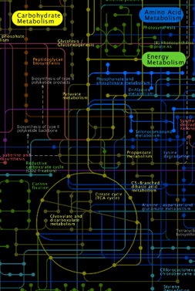
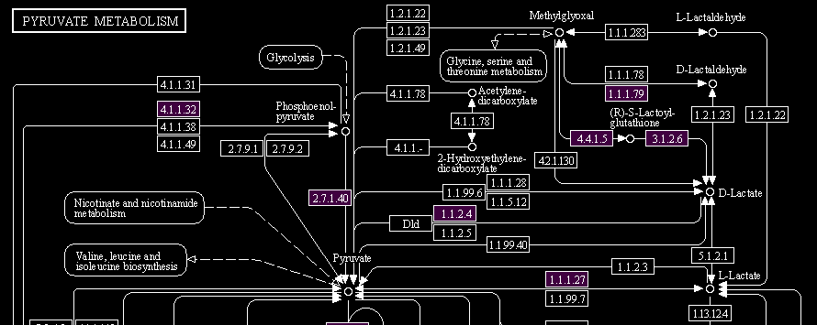



Biochemical networks
nodes
edges

Slide 33

Structural similarity networks
Use structure to generate molecular fingerprint
Calculate similarities between metabolites based on fingerprint
PubChem service for similarity calculations
http://pubchem.ncbi.nlm.nih.gov//score_matrix/score_matrix.cgi
online tools
http://uranus.fiehnlab.ucdavis.edu:8080/MetaMapp/homePage
BMC Bioinformatics 2012, 13:99 doi:10.1186/1471-2105-13-99

Slide 34

Structural similarity example

Slide 35


Treatment Effects Network
Combining
networks
Metabolites
Shape = increase/decrease Size = importance (loading) Color = correlation
Connections
violet = Biochemical relationships
green = Structural similarity
https://dgrapov.github.io/MetaMapR/gallery.html

Slide 36
Your turn
Follow along with the following tutorial:
https://creativedatasolutions.github.io/CDS.courses/courses/network_mapping_101/docs/partial/network/

Slide 37

Network refinement and visualization
learn
Cytoscape basics
map variables to
node attributes
edge attributes
optimize
layout
legend
publication quality figure
https://creativedatasolutions.github.io/CDS.courses/courses/network_mapping_101/docs/partial/cytoscape/

Slide 38
Your turn
Follow along with the following tutorial:
https://creativedatasolutions.github.io/CDS.courses/courses/network_mapping_101/docs/partial/cytoscape/

